Slide 1
Software Engineering and Human Computer Interaction

Slide 2
Today’s topics:
Web data flow
Web server configuration
Continuous Integration
Web deployment
Docker

Slide 3
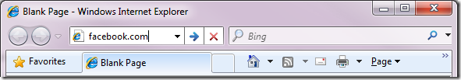

Data flow: Rendering a web page – step by step
You type an URL into address bar in your preferred browser.
The browser parses the URL to find the protocol, host, port, and path.
It forms a HTTP request (that was most likely the protocol)
To reach the host, it first needs to translate the human readable host into an IP number, and it does this by doing a DNS lookup on the host

Slide 4
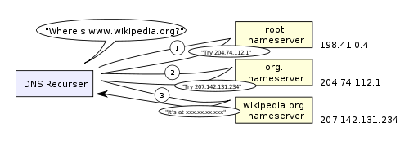
DNS Lookup
The first step in the navigation is to figure out the IP address for the visited domain. The DNS lookup proceeds as follows:
Browser cache
OS cache
Router cache
ISP DNS cache
Recursive search

Slide 5

Data flow: Rendering a web page – step by step
Then a socket needs to be opened from the user’s computer to that IP number, on the port specified (most often port 80)
When a connection is open, the HTTP request is sent to the host
The GET request has URL to fetch: “http://facebook.com/”.
The browser identifies itself (User-Agent header),
states what types of responses it will accept
(Accept and Accept-Encoding headers).
The Connection header asks the server to keep the TCP connection open for further requests.
cookies that the browser has for this domain.
cookies are key-value pairs that track the state of a web site in between different page requests.
And so the cookies store the name of the logged-in user, a secret number that was assigned to the user by the server, some of user’s settings, etc.
The cookies will be stored in a text file on the client, and sent to the server with every request.

Slide 6
HTTP Request
GET http://facebook.com/ HTTP/1.1
Accept: application/x-ms-application, image/jpeg, application/xaml+xml, [...]
User-Agent: Mozilla/4.0 (compatible; MSIE 8.0; Windows NT 6.1; WOW64; [...]
Accept-Encoding: gzip, deflate
Connection: Keep-Alive
Host: facebook.com
Cookie: datr=1265876274-[...]; locale=en_US; lsd=WW[...]; c_user=2101[...]

Slide 7
Data flow: Rendering a web page – step by step
The host forwards the request to the server software (most often Apache) configured to listen on the specified port
The server inspects the request (most often only the path), and launches the server plugin needed to handle the request (corresponding to the server language you use, PHP, Java, .NET, Python?)
The plugin gets access to the full request, and starts to prepare a HTTP response.
To construct the response a database is (most likely) accessed. A database search is made, based on parameters in the path (or data) of the request
Data from the database, together with other information the plugin decides to add, is combined into a long string of text (probably HTML).

Slide 8

Data flow: Rendering a web page – step by step
The plugin combines that data with some meta data (in the form of HTTP headers), and sends the HTTP response back to the browser.
HTTP/1.1 301 Moved Permanently
Cache-Control: private, no-store, no-cache, must-revalidate, post-check=0, pre-check=0
Expires: Sat, 01 Jan 2000 00:00:00 GMT
Location: http://www.facebook.com/
P3P: CP="DSP LAW"
Pragma: no-cache
Set-Cookie: made_write_conn=deleted; expires=Thu, 12-Feb-2009 05:09:50 GMT; path=/; domain=.facebook.com; httponly
Content-Type: text/html; charset=utf-8
X-Cnection: close
Date: Fri, 12 Feb 2010 05:09:51 GMT
Content-Length: 0

Slide 9
Data flow: Rendering a web page – step by step
The browser receives the response, and parses the HTML (which with 95% probability is broken) in the response
The server responded with a 301 Moved Permanently response to tell the browser to go to “http://www.facebook.com/” instead of “http://facebook.com/”.
The browser follows the redirect.
The browser now knows that “http://www.facebook.com/” is the correct URL to go to, and so it sends out another GET request:
GET http://www.facebook.com/ HTTP/1.1
Accept: application/x-ms-application, image/jpeg, application/xaml+xml, [...]
Accept-Language: en-US
The server ‘handles’ the request then sends back a HTML response (step 8-11).

Slide 10
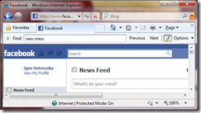
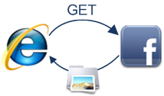
Data flow: Rendering a web page – step by step
A DOM tree is built out of the broken HTML
New requests are made to the server for each new resource that is found in the HTML source (typically images, style sheets, and JavaScript files). Go back to step 3 and repeat for each resource.
Stylesheets are parsed, and the rendering information in each gets attached to the matching node in the DOM tree
Javascript is parsed and executed, and DOM nodes are moved and style information is updated accordingly

Slide 11
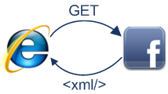
Data flow: Rendering a web page – step by step
The browser renders the page on the screen according to the DOM tree and the style information for each node
You see the page on the screen
You get annoyed the whole process was too slow.
Browser make further Ajax Request:

Slide 12
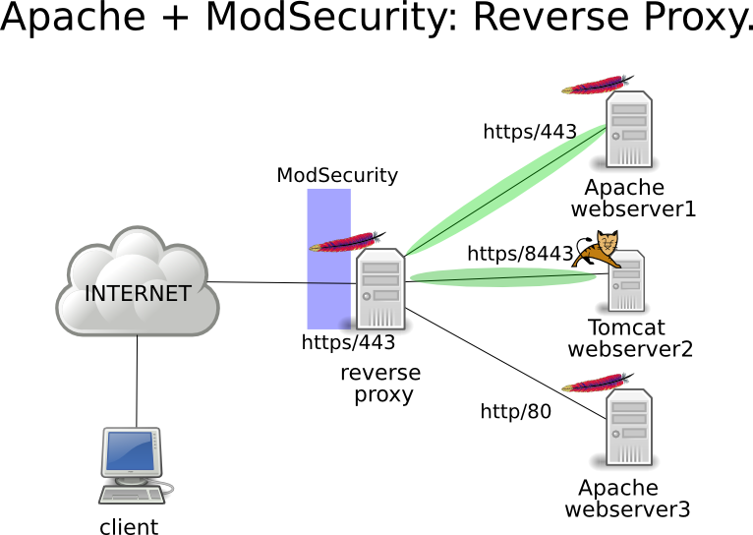
Web server configuration
Today many web server are configured using reverse proxy architecture
Reverse proxy ex.: apache, Nginx
Applications ex.:
PHP
Ruby
Python
C# (asp.net)
Node js

Slide 13
Continuous Integration
See in separated slides.

Slide 14
Web deployment
Database server
Server configuration
Deployment tool & script.
SSH
Capistrano, Mina, Heroku
Services (SaaS, PaaS, Docker, Vagrant, Virtual Machine, Cloud, etc.)

Slide 15
Docker
See in separated slides.

